Slide 1
Gradient Descent

Slide 2
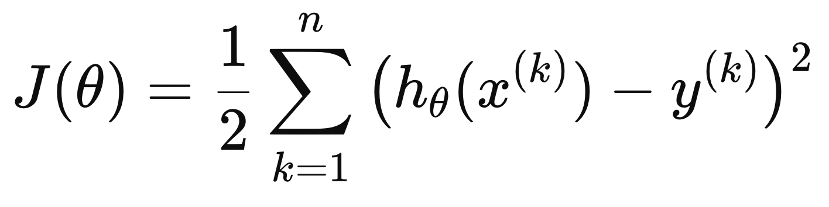
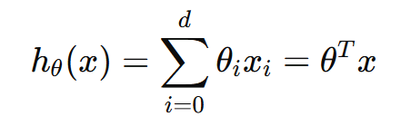

Linear Regression (Recap)
Goal:
Given a training set, learn $θ$
Such that $h_{θ}(x)$ is as close as possible to $y$
For a dataset with n samples, minimize
Least Mean Squares (LMS)
Cost Function/Loss Function

Slide 3

Linear Regression
Goal: Choose $θ$ to minimize $J(θ)$
$$θ^{∗}=argmin_{θ}J(θ)$$
How?
Gradient Descent

Slide 4
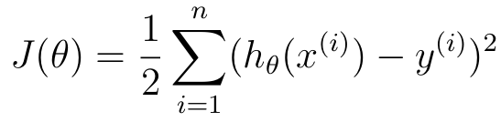
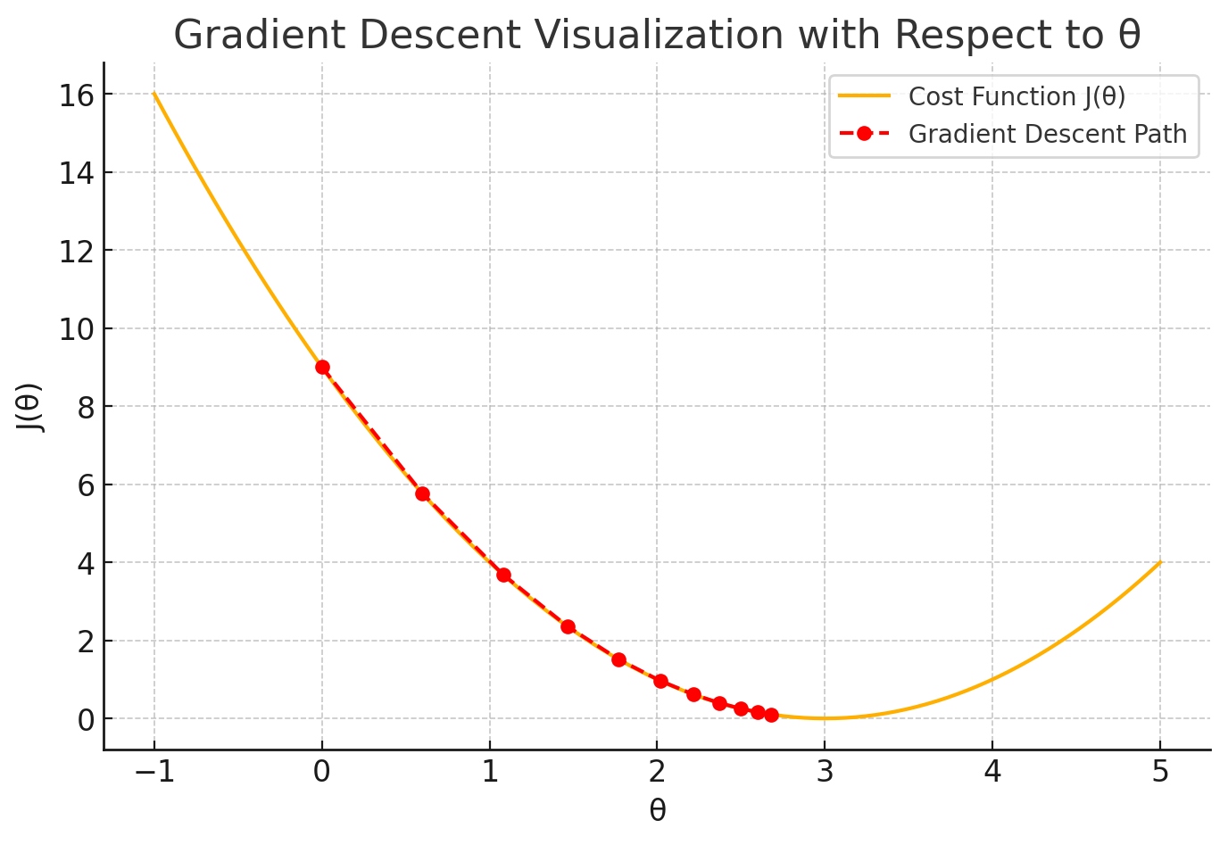
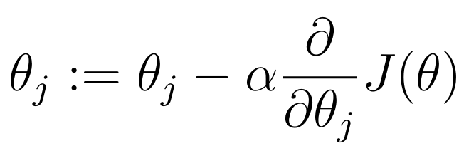
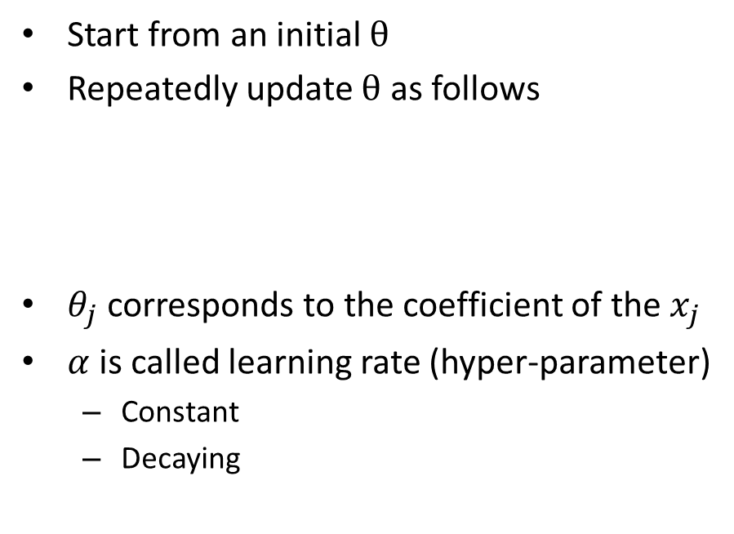
Gradient Descent
Cost Function
Start from an initial $θ$
Repeatedly update $θ$ as follows
$θ_{j}$ corresponds to the coefficient of the $x_{j}$
$α$ is called learning rate (hyper-parameter)
Constant
Decaying

Slide 5
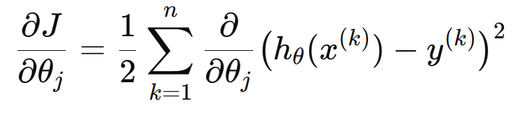
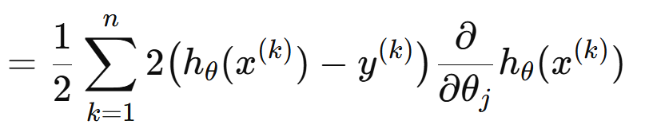
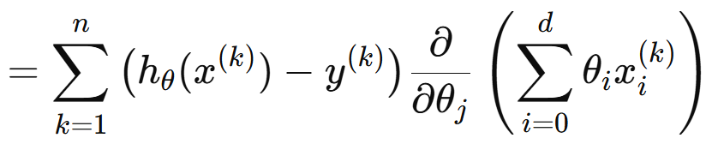
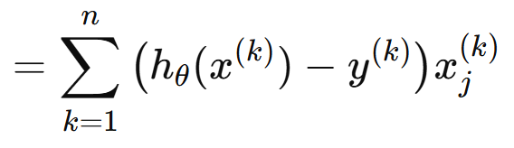
Gradient Descent
Cost Function

Slide 6
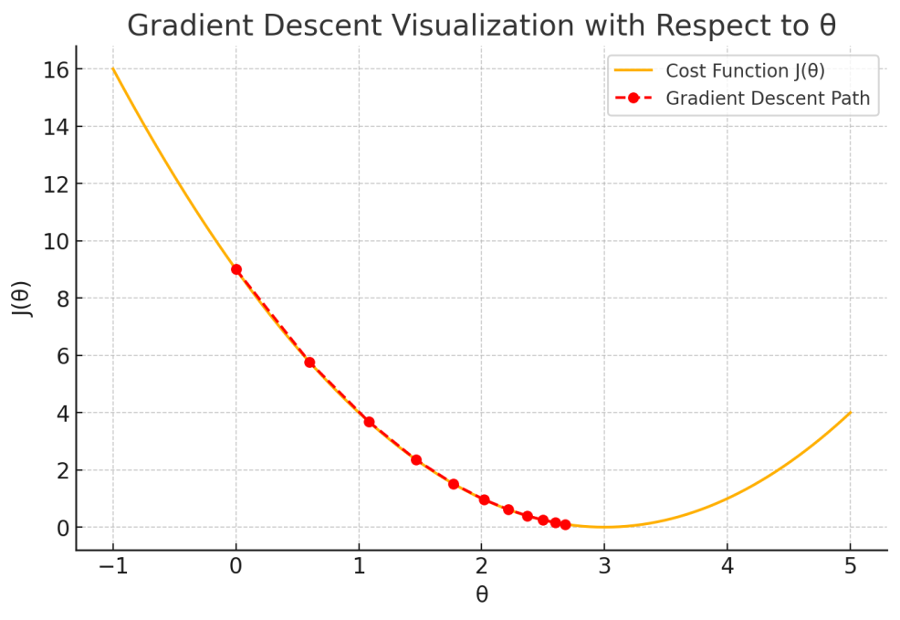
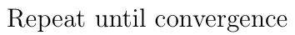
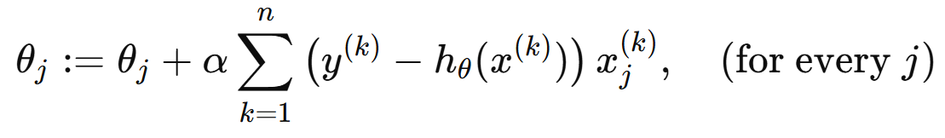
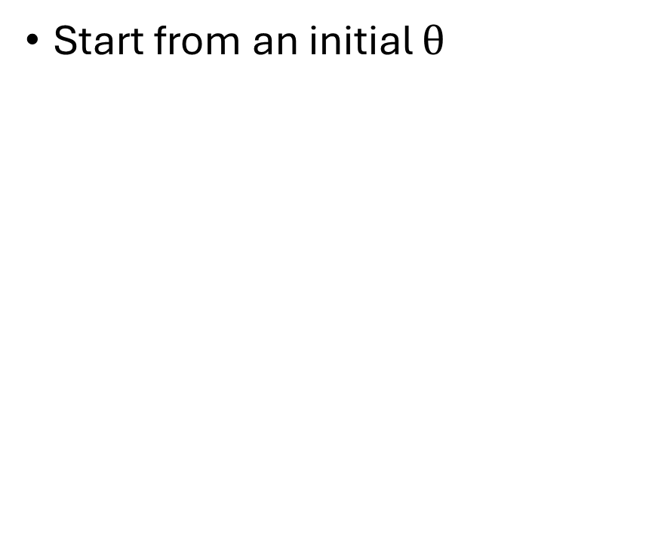
Gradient Descent
Cost Function
Start from an initial $θ$

Slide 7
The Three Flavors of Gradient Descent
Batch Gradient Descent
Use all n samples to compute the gradient
Exact gradient
Stable Updates
Slow, memory intensive
Stochastic Gradient Descent
Use 1 sample to compute the gradient
Very fast updates
Noisy gradient, Convergence issues
Mini-batch Gradient Descent
Use a small batch of samples
Reasonably stable
Most used choice

Slide 8
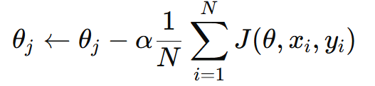
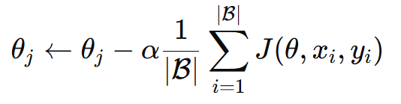


The Three Flavors of Gradient Descent
Let, $J\left(θ, x, y\right)$ is the loss from sample (x, y)
Batch Gradient Descent
Stochastic Gradient Descent
Mini-batch Gradient Descent

Slide 9
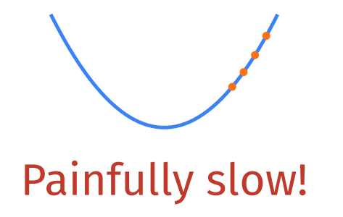
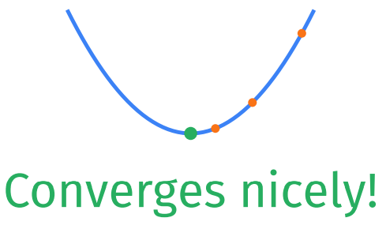
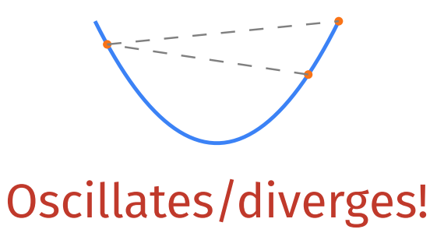
Learning Rate
Too small
Too Large
Just Right

Slide 10
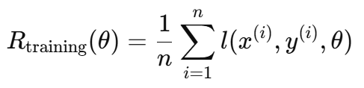


Generalization
Training Error and Generalization Error
Let, $l\left(x, y,θ\right)$ is the error from sample (x, y)
Training Error
Generalization Error

Slide 11
Generalization
IID Assumption
The training data and the test data are drawn independently from identical distributions.
We cannot sample an infinite stream of data points
Estimate generalization error on the test set
Same formula as training error applied on the samples in the test set.

Slide 12
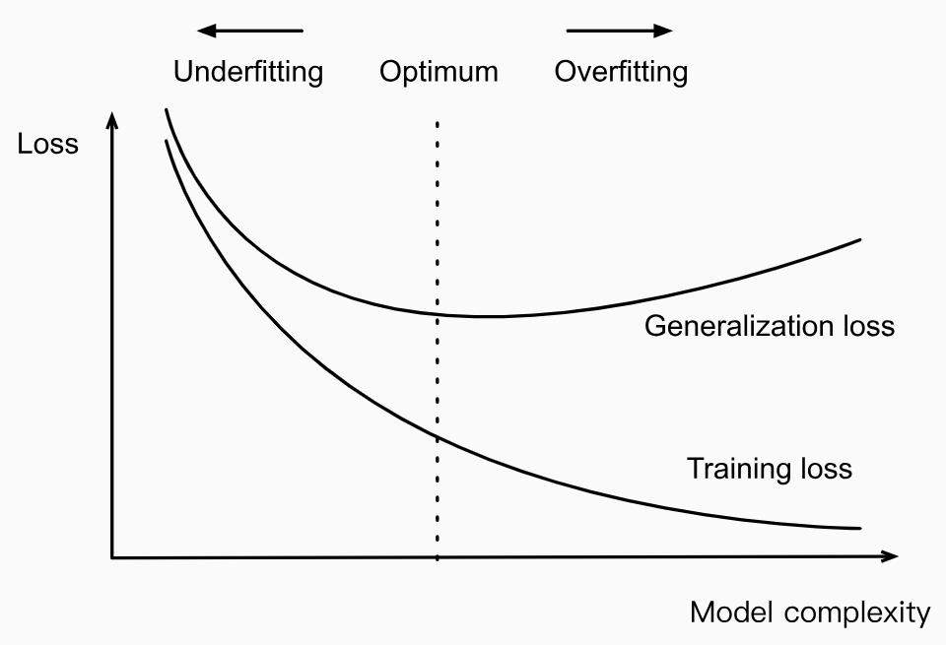
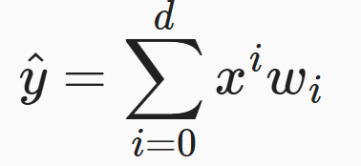

Underfitting or Overfitting
Polynomial Curve Fitting
Training data consisting of
a single feature $x$
corresponding real-valued label $y$
Find the polynomial of degree $d$

Slide 13
Dataset Size
With a fixed model
The fewer samples in the training dataset, the more likely to overfit.
As we increase the amount of training data, the generalization error typically decreases.
More data typically helps.
For a fixed task and data distribution,
Given sufficient data, attempt to fit a more complex model.
Absent sufficient data, simpler models may be more difficult to beat.

Slide 14
Reference
D2l
Gradient Descent: 12.3 (up to 12.3.2)
Generalization: Section 3.6 (up to 3.6.2.2)
Deep Learning
Section 8.1

